Slide 1
Food recognition and segmentation
Yang Mingyuan
Cheng Wantong
Ma Zhiwei
Fan Pengbo
2025.2.18

Slide 2
Table of Contents
1. Competition description
2. Description of the data set
3. Description of the solution
4. Summary
5. Description of competition 1
6. Description of competition 1’s model
7. Description of competition 2
8. Description of competition 2’s model

Slide 3

Competition description
Recognizing food from images is an extremely useful tool for various use cases. In particular, it would allow people to track their food intake by simply taking a picture of what they consume.
The competition is to identify pictures of food that people eat and analyze the composition of the food in the pictures.

Slide 4
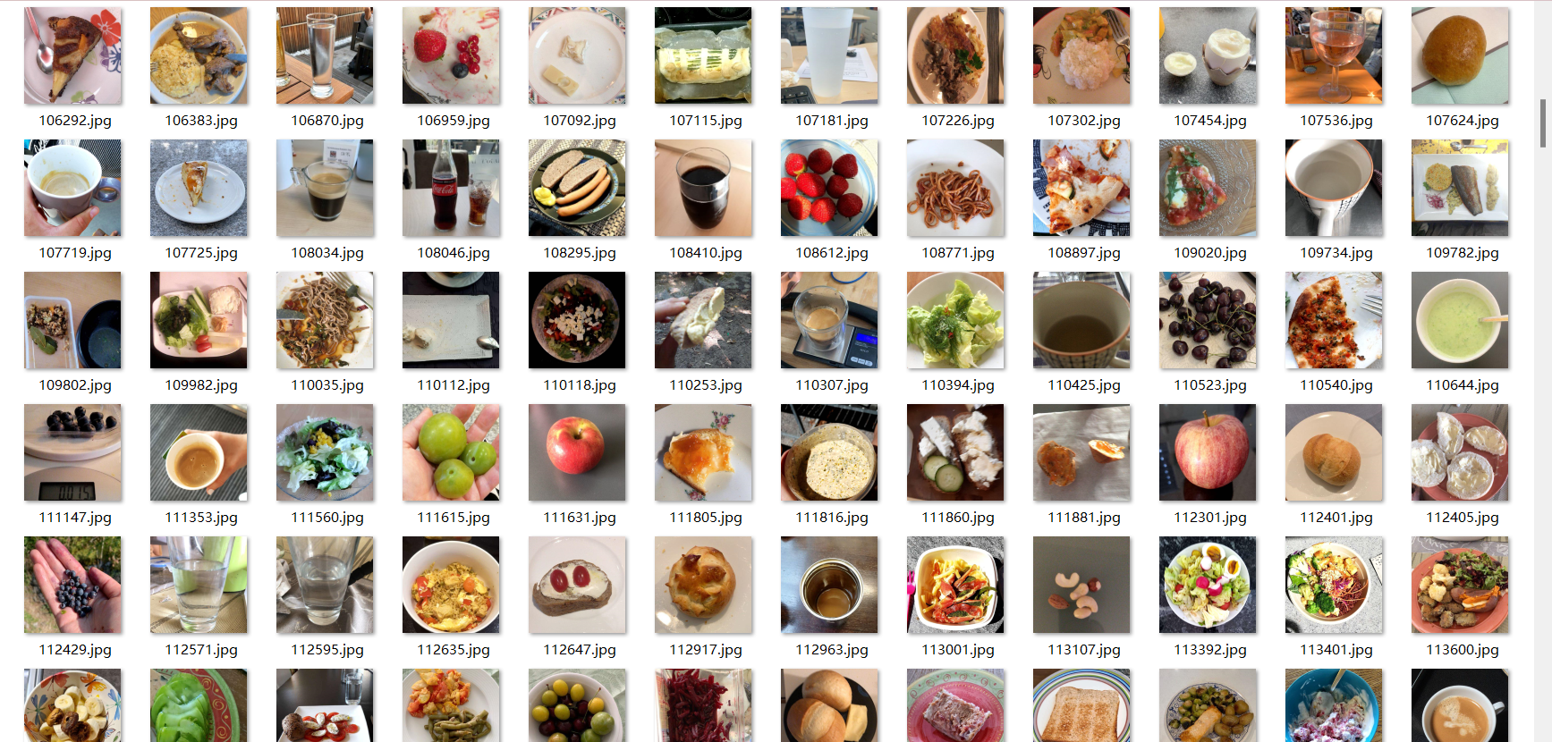
Description of the data set
The competition uses a novel dataset of food images collected through the MyFoodRepo app, where numerous volunteer Swiss users provide images of their daily food intake in the context of a digital cohort called Food & You.

Slide 5
Description of the solution
Participant 1 used MMDetection framework and Mask R-CNN model to automatically detect and segment food objects in images, generate boundary boxes and segment masks, and solve the task of image object detection and segmentation.
Participant 2 used the instance segmentation model (such as Mask R-CNN) in the MMDetection framework to detect and accurately segment food images, and evaluated the model performance by calculating evaluation indexes such as mAP and mAR.
Participant 3 used MMDetection framework and pre-trained object detection model (such as HybridTaskCascade) for image inference, and solved object detection and instance segmentation problems.

Slide 6

Competition description
The challenge aims to improve image-based product search on e-commerce platforms through computer vision technology, addressing the limitations of traditional text search. Using more than 40,000 images from real markets, covering 9,000 products, the challenge evaluates the performance of image retrieval algorithms in real scenarios, especially in dealing with factors such as image perspective, background clutter, and quality changes.

Slide 7
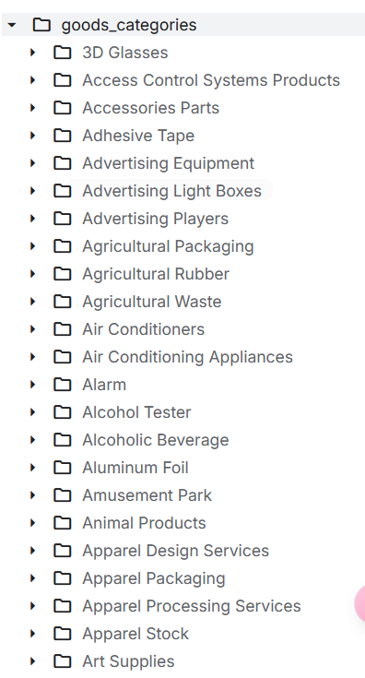
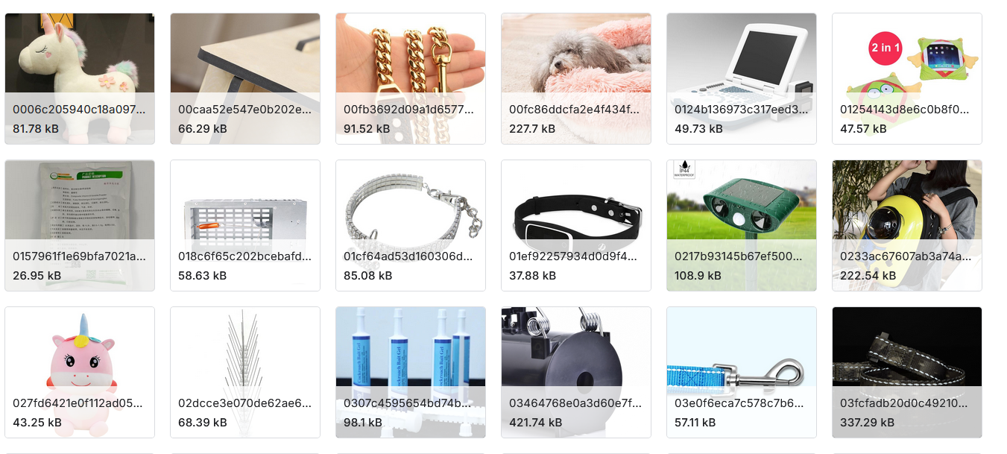
Description of the data set
Dataset contains images extracted for a subset of alibaba goods categories. Each good contains one or several photos.

Slide 8
Description of the solution
Participant 2 trained a deep learning model based on XBM (eXtreme-Backpropagation Memory) technology for image classification and retrieval on e-commerce platforms. Through image enhancement, pre-trained model loading, and PyTorch Lightning, the model efficiently processes large-scale image data and improves the visual search capabilities of e-commerce platforms. Learning rate monitoring, early stopping, and model checkpoint callbacks are used during training to optimize performance

Slide 9
Summary
We chose the food-recognition-benchmark-2022 competition because the experimental data provided in this competition is more complete. If we do this experiment, it can provide more reference schemes to compare and modify our experiments.

Slide 10
Description of competition 1
Participant 1 realized food detection and evaluation. He used a deep learning model to process images, detect food targets, generate prediction results, calculate evaluation indicators such as average precision mean (mAP) and average recall mean (mAR), and finally output detection results to analyze the composition of food in the pictures.
1.Load Test Image
2.Preprocessed Image
3.Load Detection Model
6. Compute Evaluation(mAP, mAR)
5.Generate Predictions
4. Perform Object Detection
7.Output Final Result

Slide 11
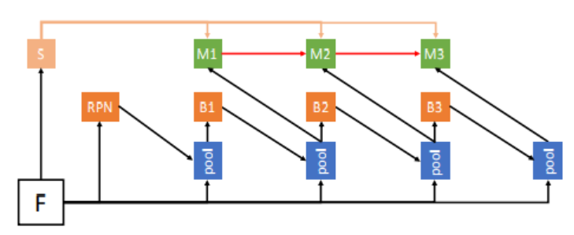
Description of competition 1’s model
The model generates target region recommendations through RPN, uses pool layer (pool) to process features, then transforms and transmits features through intermediate modules (M1,M2,M3), and finally gives the results of target detection or related tasks by output modules (B1,B2,B3).

Slide 12
Description of competition 1’s model
1.Firstly, the image is loaded and preprocessed, the data file is read, and the width and height of the image are obtained by using PIL (Pillow) library to open the image. And set some algorithms for controlling target detection. For example: leave extra space for the detection box, prevent cutting the target, and split the number of points in the area and so on.
2.Using PyTorch to load the pre-trained model and optimize the model size by removing the optimizer parameters is suitable for efficient deployment in the inference phase.

Slide 13
Description of competition 1’s model
3.Load the model configuration file with the MMDetection framework, load the Detectron2 pre-training model, and perform instance segmentation. HybridTaskCascade model is used to model the image, and the bounding box and segmentation results are obtained. The output results of the model are post-processed, and the final detection and segmentation results are displayed. Run object detection and generate JSON prediction files for evaluation and submission.
4.Score calculation is mainly based on IoU(Intersection over Union), Precision-Recall curve, mAP and AR. NumPy is used to calculate IoU, Scikit-learn is used to calculate AP (AUC), and finally mAP and AR evaluation indicators are obtained. Evaluate the accuracy of test results.

Slide 14
Description of competition 2
The overall goal is to build a target detection model based on Cascade R-CNN, using Swin Transformer as the backbone network, combining feature pyramid network (FPN) for multi-scale feature fusion, and then generating candidate boxes through region proposal network (RPN), and finally using multi-stage detection head (Hybrid Task Cascade RoI Head) for target detection.

Slide 15
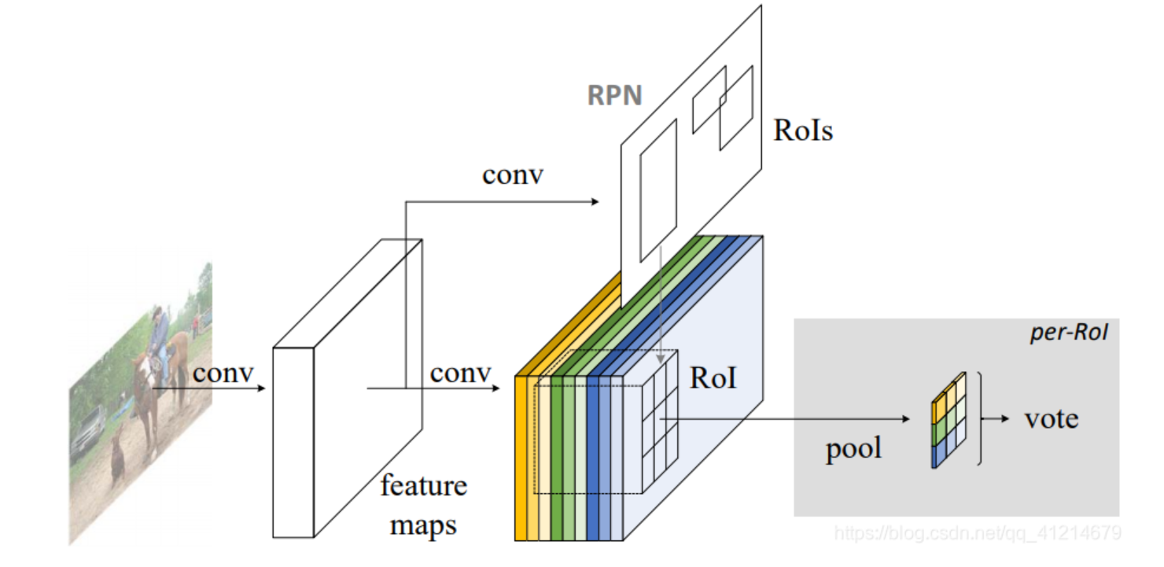
Description of competition 2’s model
Feature extraction: The input image first goes through a series of conv operations to generate feature maps. This step is to extract various features in the image.
Regional Suggestion Network (RPN) : Based on the generated feature map, the RPN generates a series of RoIs (Regions of Interest) that may contain targets, which are candidate regions where the model thinks objects may exist.
RoI Pooling: Map the RoIs generated by the RPN to the feature map, and convert the RoI feature map of different sizes to a fixed size through the RoI Pooling operation for subsequent processing.
Classification and regression: Categorize each RoI, determine the category of objects it contains, and perform bounding box regression to precisely adjust the position and size of the target object. Finally, the final test result is determined by voting and other means.

Slide 16
Description of competition 2’s model
Input Image
Swin Transformer
Feature Pyramid Network(FPN)
Output (Detection Boxes) and Classes
HybridTaskCascadeRoIHead
Region Proposal Network(RPN)

Slide 17
Description of competition 2’s model
Swin Transformer
Swin Transformer is a visual model based on the Transformer architecture. It can effectively capture local and global information when processing image data by introducing a sliding window mechanism, and has good feature extraction capabilities.
Feature Pyramid Network(FPN)
FPN can fuse feature maps of different scales, so that the model can perform well in detecting objects of different sizes, solving the problem of scale change in object detection.

Slide 18
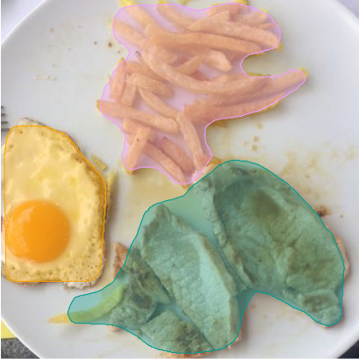
Description of competition 2’s model
Region Proposal Network(RPN)
Generate candidate boxes through the region proposal network (RPN). The main function of RPN is to quickly generate candidate regions that may contain targets in the image, reducing the search space for subsequent detection.
Hybrid Task Cascade RoI Head
Use a multi-stage detection head (Hybrid Task Cascade RoI Head) for object detection. This detection head gradually improves the accuracy of the detection box through multiple stages of iteration, and can also handle multiple tasks such as instance segmentation

Slide 19
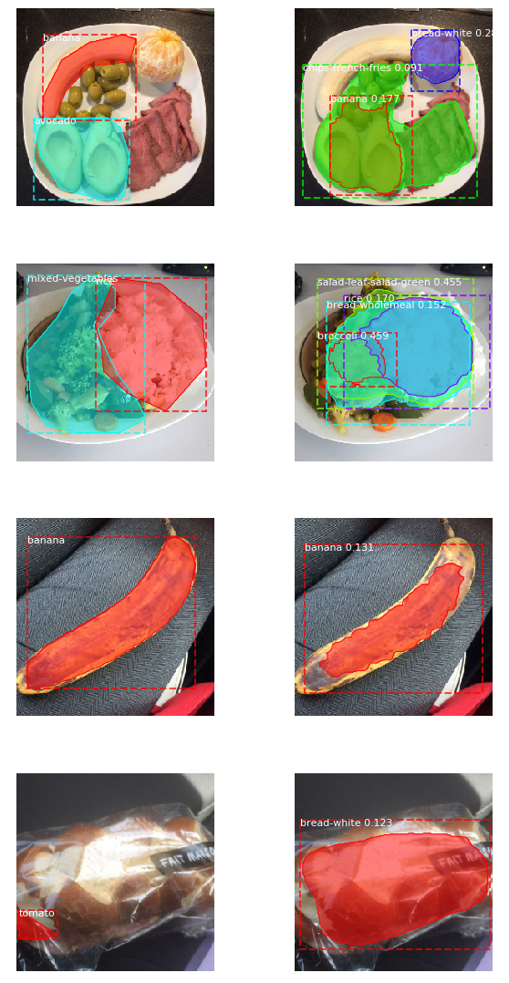
Load the trained R-CNN model and set it to inference mode. In this mode, the model is used to process new image data and output corresponding prediction results.
Randomly select four images from the validation set, then for each image, load its ground truth, including the true classes, bounding boxes, and segmentation masks.

Slide 20
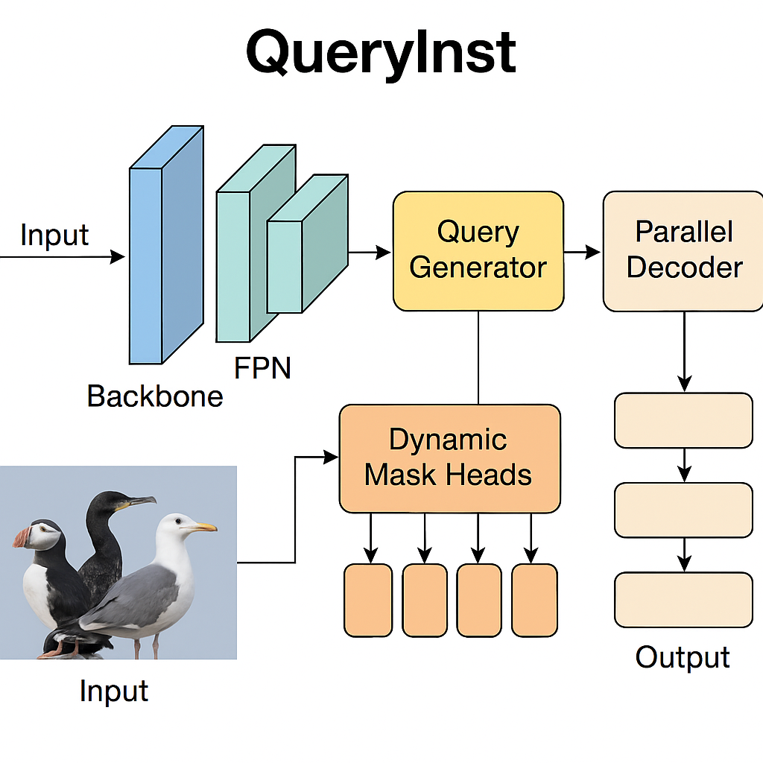
QueryInst
QueryInst is an end-to-end instance segmentation model, which unifies object detection and instance mask generation into a query-driven process. Use learnable queries to represent each instance, extract features and generate masks through a parallel attention mechanism.

Slide 21
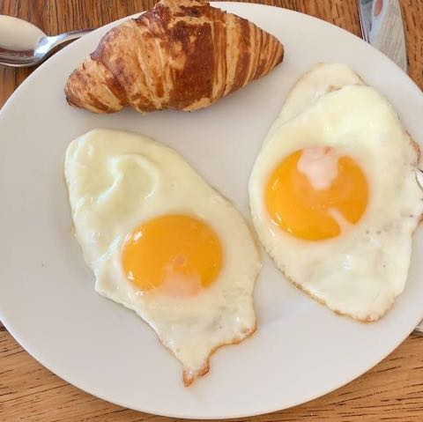
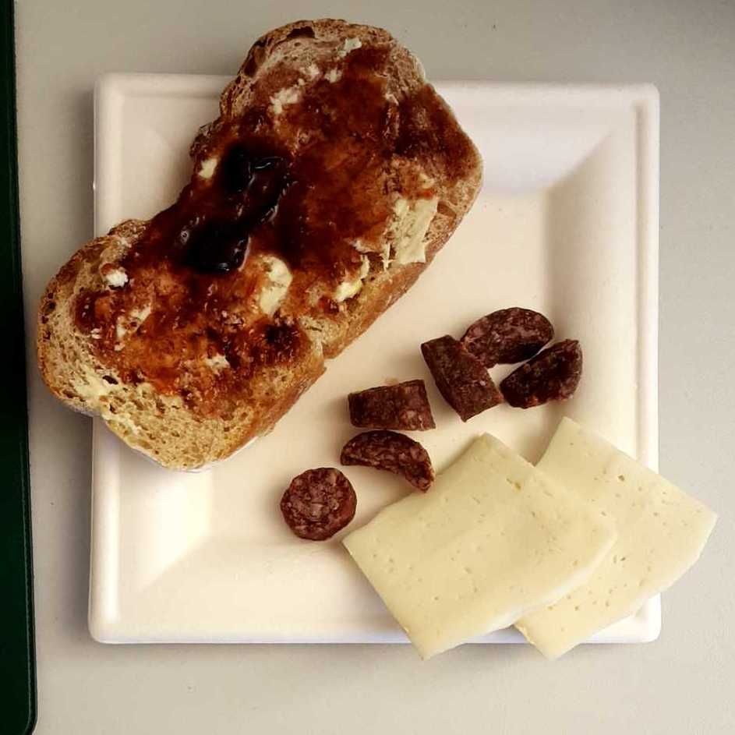
Result
Example 1
Top1 score
"score": 0.9048388263254726
Our score
"score": 0.668030386461957
Example 2
Top1 score
"score": 0.863557991437074
Our score
"score": 0.7563078454801179

Slide 22
Thanks for listening

